Slide 1
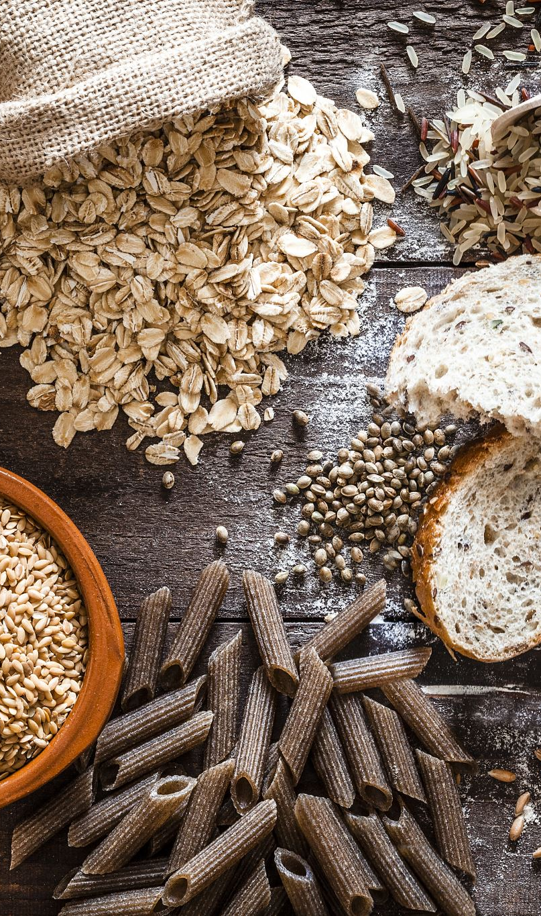
Inverse Nutritional Mapping
Andy Golebiewski
Eric Loux
Chandler Stewart
Nash Hearn
Trevor Miles
Notes:
Greet audience, introduce group as a whole (not as individuals)

Slide 2
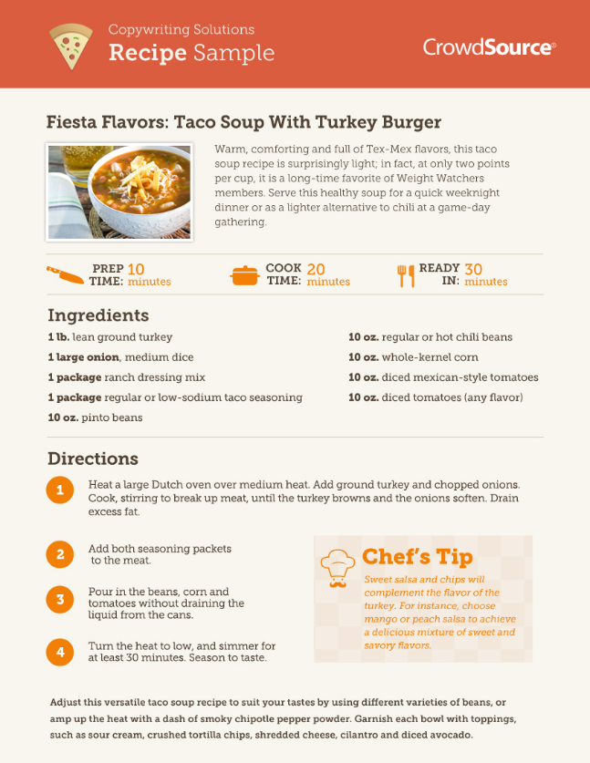
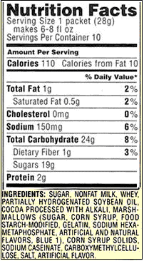
Project Overview
Background
Goal
Limitations/Assumptions
Nutritional Information
Ingredient Order
Nutritional Information
Ingredient Order
Notes:
We chose the domain of nutrition; specifically relationship between recipe and nutritional information
Calculating nutritional information from a recipe is straightforward. One limitation is frying things.
The other direction is more difficult, this is our project basis: to take nutritional information and derive the quantities of ingredients that went into the food
Three main parts of a nutrition facts label; serving size, nutrients, and ingredients. The serving size is not used in our project. Nutrients show the quantities of at least 13 nutrients which we limited our model to. Some have more or less, why? We limited to just 13. Ingredients list shows ingredients in order from most to least. There are a lot of potential ingredients (FDA has over 3000) so we limited to only bread (15 ingredients). Here’s how those fit into our broader project architecture

Slide 3
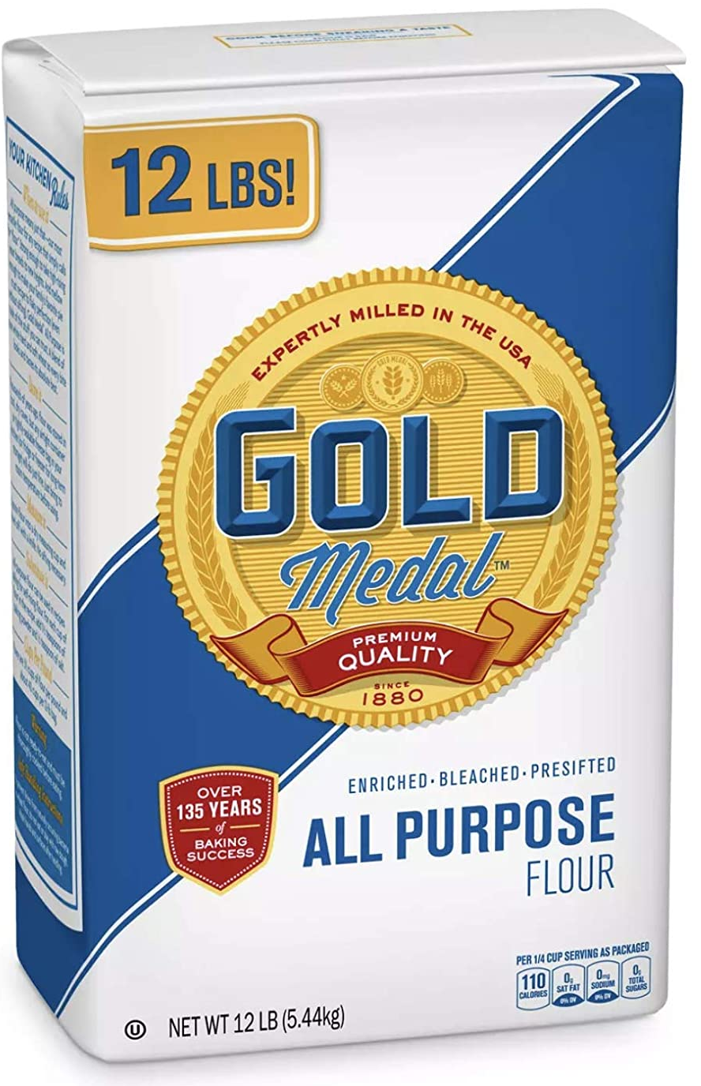
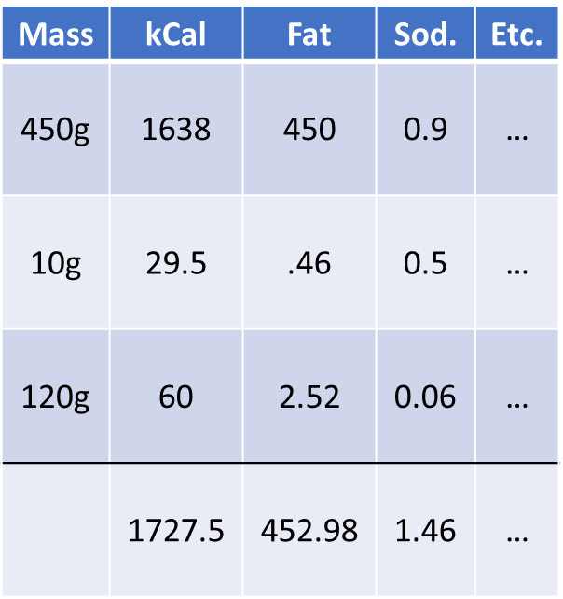
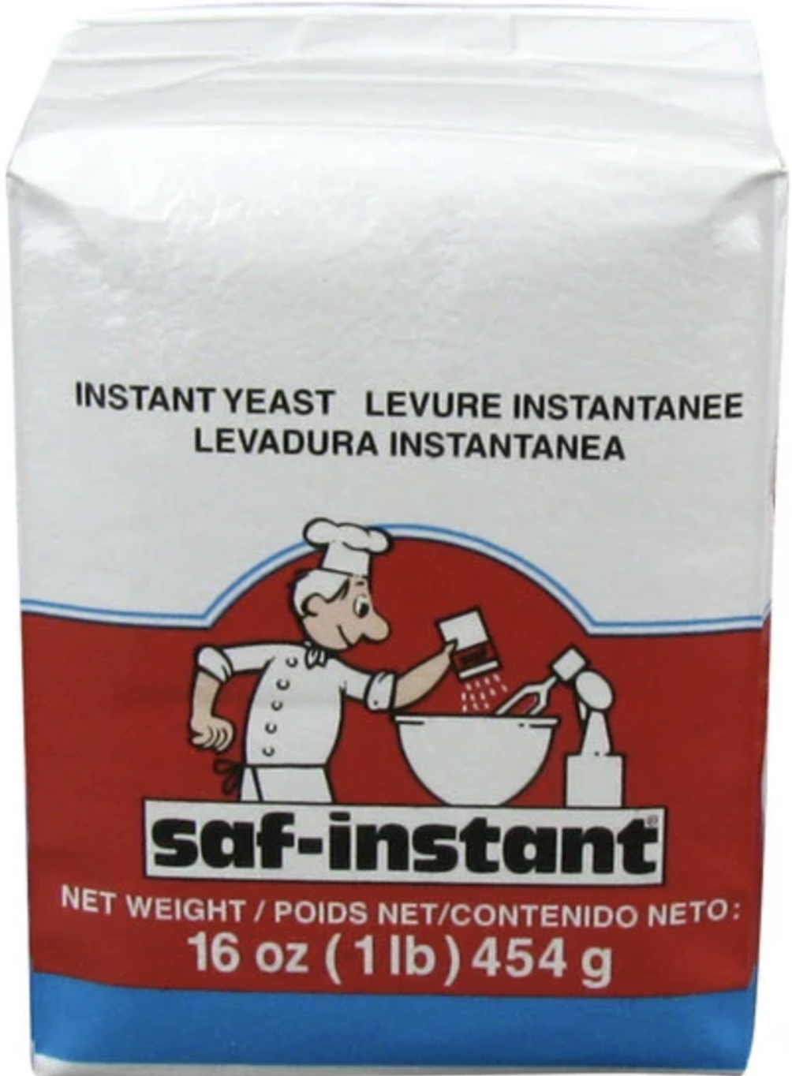
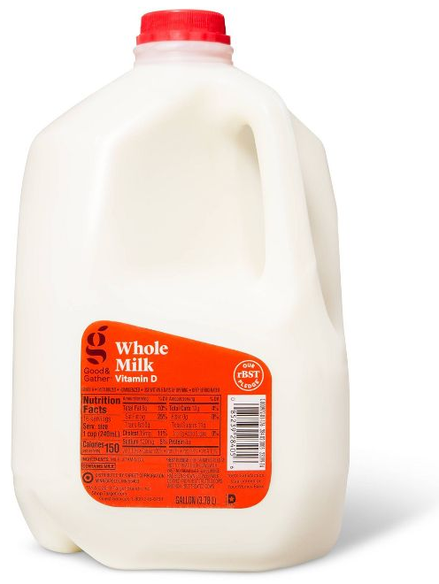
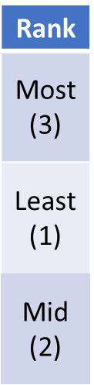
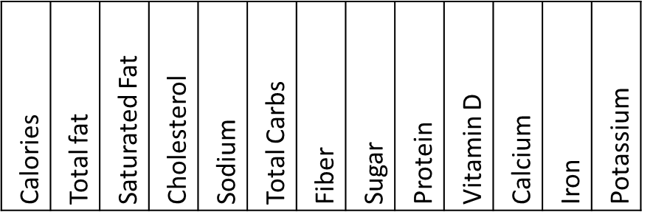
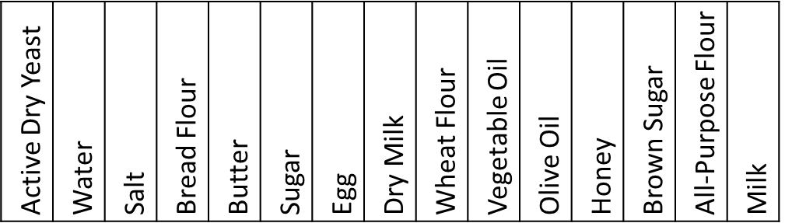
Project Architecture
13
Recipe Generator
0
Nutrition Calculator
Ingredient Ordinalizer
14
Nutritional Information
Ingredient Order
Nutritional Information
Ordinal Ingredient List
Neural Network
Ingredient Quantities
1 0 0 0 0 0 0 0 0 0 0 0 0 3 2
Notes:
Here is the overview. Recipe generation explained in depth later.
Nutrition calculator uses recipe to sum nutrients
The ordinal ingredient list uses recipe to sort ingredients
From there it enters the neural network to derive ingredient quantities
Here’s an example of what the recipe generator might make, selecting ingredients and their masses
With those we can calculate each ingredient’s nutrients
And from there sum the amounts of each nutrient, giving us the nutritional information input
Using just the masses, we can put them in order then assign that ingredient its relative quantity
Zeroes are assigned to ingredients not present
The masses generated are also used for validation

Slide 4
Data Sourcing
Generate “bready” recipes
Ingredient scaling based on amount of yeast
Group ingredients based on function
Yeast
Liquid
Flour
Sweet
Lipid
Salt
Egg
Dry Milk
15g
Bread
Flour
60%
None
20%
None
25%
Water
80%
Sugar
20%
Butter
25%
Yes
90%
All Purp.
Flour
30%
Brown
Sugar
10%
V. Oil
25%
Both
(10%)
Yes
20%
O. Oil
25%
Yes
10%
2.5g
Wheat
Flour
10%
Milk
(10%)
Honey
10%
Notes:
Couldn’t find a large digital source of recipes so we made a recipe generator for testing data and then transcribed 12 recipes to use as validation data. Our generator worked on two assumptions about bread recipes: they all have yeast, and that several other ingredients could be grouped according to function.
First: All recipes had an amount of yeast between 2.8g and 14g so our generator pulls from slightly beyond that range
Based on which ingredients were mutually exclusive and the likelihood of each ingredient to exist in the recipe we found four groups of ingredients. We calculated stdev and mean of the ratio of the mass of each ingredient to yeast. Each “silo” has its own random number seed that uses this info to determine which ingredients to select as well as the quantities of each
There were three other ingredients that didn’t fit into a group so their presence was determined individually

Slide 5
Neural Network Component
Deep residual network
MSE (Regression)
Include loss graph here
Notes:
With a regression problem we need to assess accuracy based on loss.

Slide 6

Individual Contributions
Notes:
Add during meeting
Andy – Found a way to calculate nutrition facts of each ingredient, wrote readme
Nash Hearn – Helped with presentation
Eric Loux – Strategic and tactical oversight, created presentation, small tweaks to data generation code
Trevor Miles – Created demo
Chandler Stewart – Designed and built the network, data generation, and created accuracy function

Slide 7
Demo
link

